Slide 1
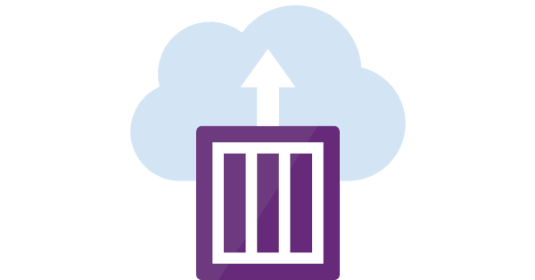
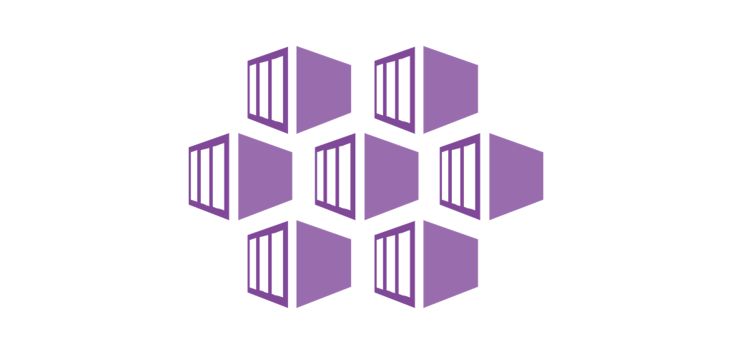

Azure Container Instances
&
Azure Kubernetes Services
Sunny Sharma

Slide 2
Agenda
ACI
Container Groups
Volume Mounting
ACI Integration with
Azure Functions
Logic Apps
Kubernetes Services
AKS
CI/CD pipeline using Docker and VSTS

Slide 3
Azure Container Instances is the quickest and easiest way to run a container in Azure
Notes:
It offers a serverless model where you don't need to worry about provisioning virtual machines in advance and a per-second billing model so you pay for exactly what you use and no more

Slide 4
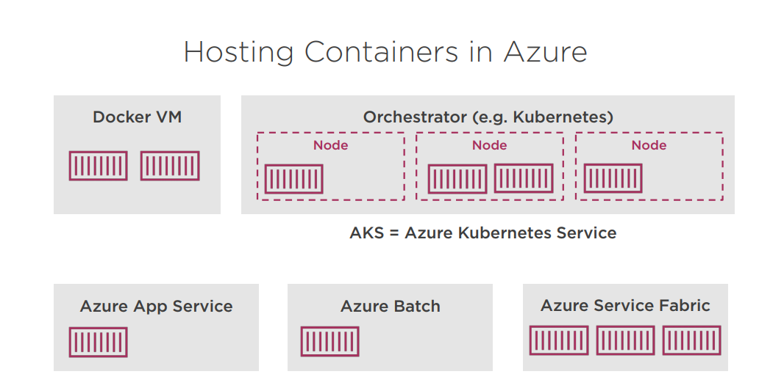
Notes:
It offers a serverless model where you don't need to worry about provisioning virtual machines in advance and a per-second billing model so you pay for exactly what you use and no more

Slide 5
Why Azure Container Instances?
Quick Experiments:
VMs take time to start
you may not want to re-use
“Serverless” containers
Managed service
Per-second billing
Notes:
It offers a serverless model where you don't need to worry about provisioning virtual machines in advance and a per-second billing model so you pay for exactly what you use and no more

Slide 6
When to use?
For occasional workloads
When not to use?
For continuously running workloads
Notes:
It offers a serverless model where you don't need to worry about provisioning virtual machines in advance and a per-second billing model so you pay for exactly what you use and no more

Slide 7
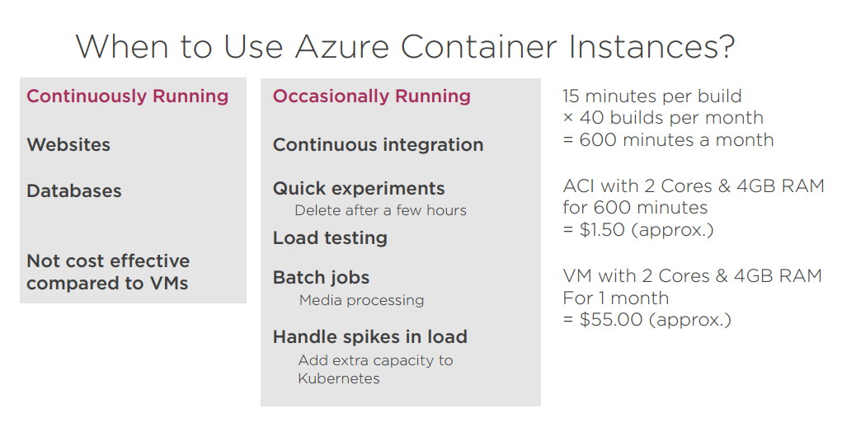
Notes:
It offers a serverless model where you don't need to worry about provisioning virtual machines in advance and a per-second billing model so you pay for exactly what you use and no more

Slide 8
ACI Features
Easy to create
Azure CLI
Powershell
C# Fluent SDK
ARM Template
Networking
Public IP Address
DNS prefix
Expose Ports
Notes:
It offers a serverless model where you don't need to worry about provisioning virtual machines in advance and a per-second billing model so you pay for exactly what you use and no more

Slide 9
More ACI Features
Container Types: Windows/Linux
Restart Policy
Mount Volumes
Azure File Share
Secrets
Git Repository
Notes:
It offers a serverless model where you don't need to worry about provisioning virtual machines in advance and a per-second billing model so you pay for exactly what you use and no more

Slide 10
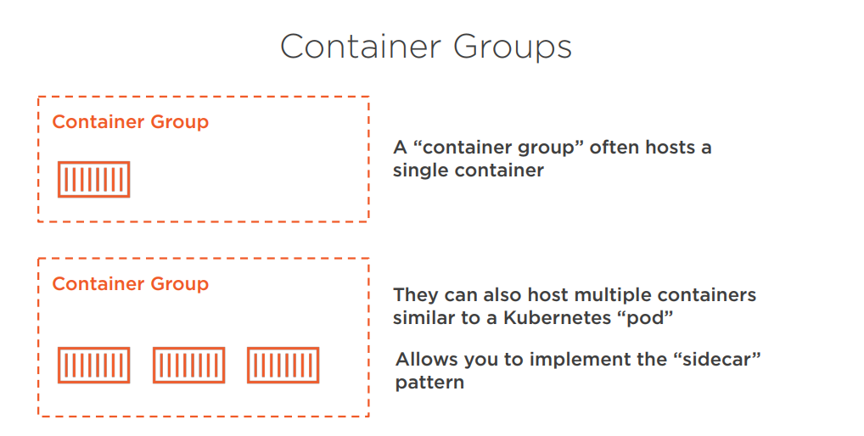
Notes:
It offers a serverless model where you don't need to worry about provisioning virtual machines in advance and a per-second billing model so you pay for exactly what you use and no more

Slide 11
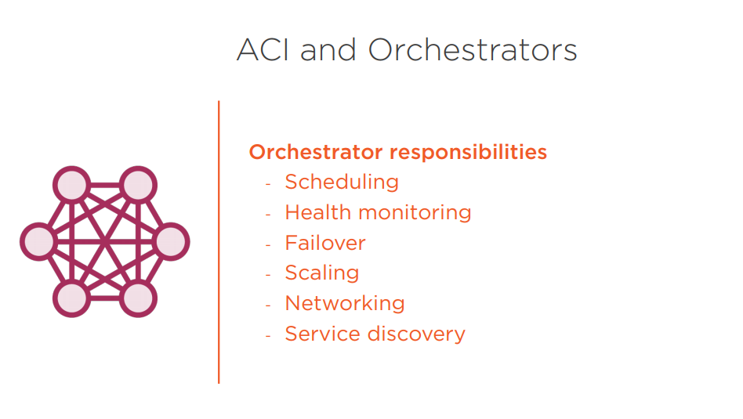
Notes:
It offers a serverless model where you don't need to worry about provisioning virtual machines in advance and a per-second billing model so you pay for exactly what you use and no more

Slide 12
ACI is not intended to be an
orchestrator
Notes:
It offers a serverless model where you don't need to worry about provisioning virtual machines in advance and a per-second billing model so you pay for exactly what you use and no more

Slide 13
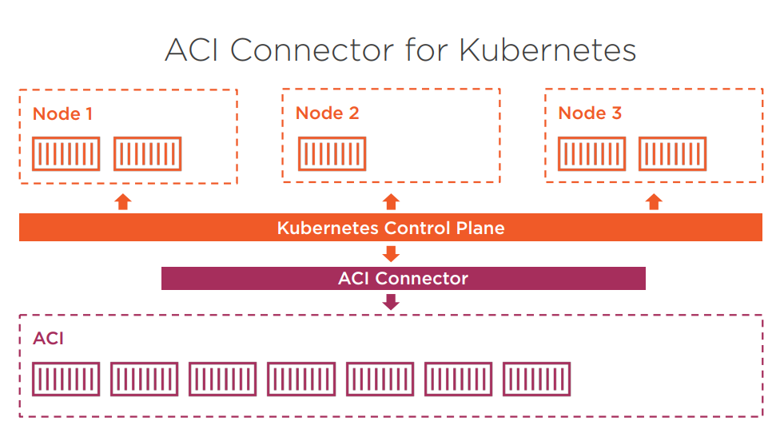
Notes:
It offers a serverless model where you don't need to worry about provisioning virtual machines in advance and a per-second billing model so you pay for exactly what you use and no more

Slide 14
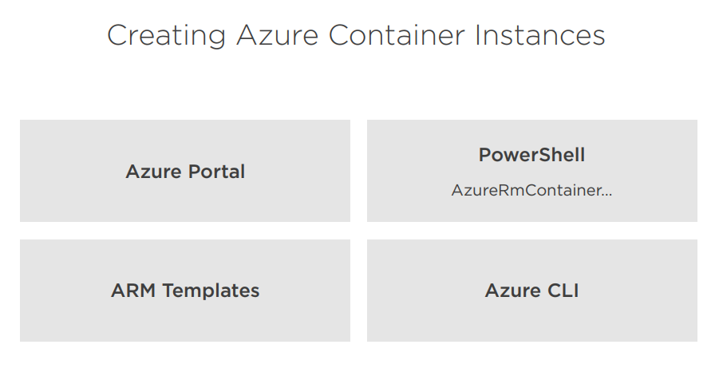
Notes:
It offers a serverless model where you don't need to worry about provisioning virtual machines in advance and a per-second billing model so you pay for exactly what you use and no more

Slide 15
A volume is external storage to a container.
Containers are disposable; volumes can be re-attached
Notes:
It offers a serverless model where you don't need to worry about provisioning virtual machines in advance and a per-second billing model so you pay for exactly what you use and no more

Slide 16
Supported volumes in ACI
Azure File Share Volumes: RAM-backed file system, never written to disk
Git Repositories: for CI builds
Secret Volumes: Secure storage of secrets
Empty Volumes
- Share data between containers in a container group
Notes:
It offers a serverless model where you don't need to worry about provisioning virtual machines in advance and a per-second billing model so you pay for exactly what you use and no more

Slide 17
Azure Container Instances
Quotas & Limits
https://docs.microsoft.com/en-us/azure/container-instances/container-instances-quotas
Notes:
It offers a serverless model where you don't need to worry about provisioning virtual machines in advance and a per-second billing model so you pay for exactly what you use and no more

Slide 18
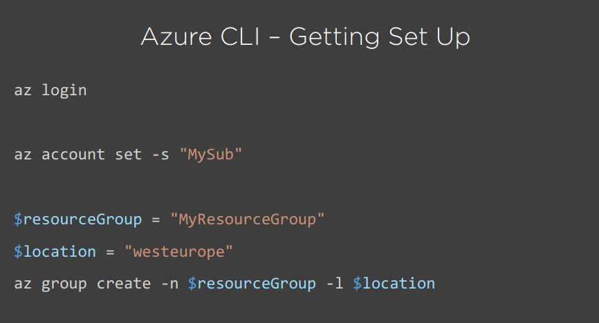
Notes:
It offers a serverless model where you don't need to worry about provisioning virtual machines in advance and a per-second billing model so you pay for exactly what you use and no more

Slide 19
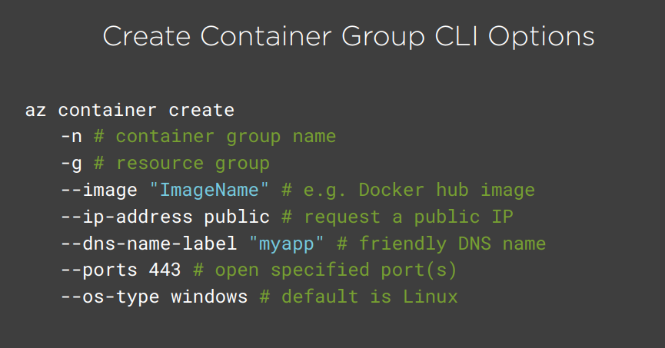
Notes:
It offers a serverless model where you don't need to worry about provisioning virtual machines in advance and a per-second billing model so you pay for exactly what you use and no more

Slide 20
who am I ?
Sunny Sharma
Lead Engineer at BizTalk360
MCT, MCSE
email: sunny.ksharma@outlook.com
twitter: @sunny_delhi
+91-9582207489

Slide 21

Thanks for joining in today!! https://aka.ms/aci

